Slide 1
Re-imagining the Future of Mining Sites
EPA Superfund Redevelopment Initiative
Wednesday, December 7, 2016

Slide 2
Webinar Overview
Introduction to SRI
Melissa Friedland, EPA Superfund Redevelopment Initiative
Ecological Revitalization at Mining Sites
Michele Mahoney, EPA Technology Innovation and Field Services Division
Re-imagining Kennecott: Kennecott North and South Zones Site History
Kerri Fiedler, EPA Region 8
Re-imagining Kennecott: Remediation and Maintenance
Douglas Bacon, Utah Department of Environmental Quality
Re-imagining Kennecott: Collaboration for Successful Residential and Ecological Reuse
John Birkinshaw, Kennecott
Lessons Learned and Collaboration Tools
Kerri Fiedler, Douglas Bacon and John Birkinshaw
Resources, Contacts and Questions
Melissa Friedland

Slide 3
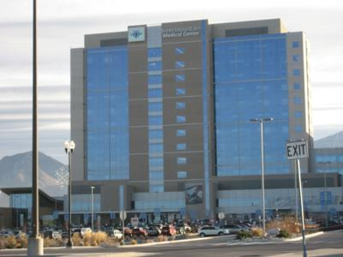
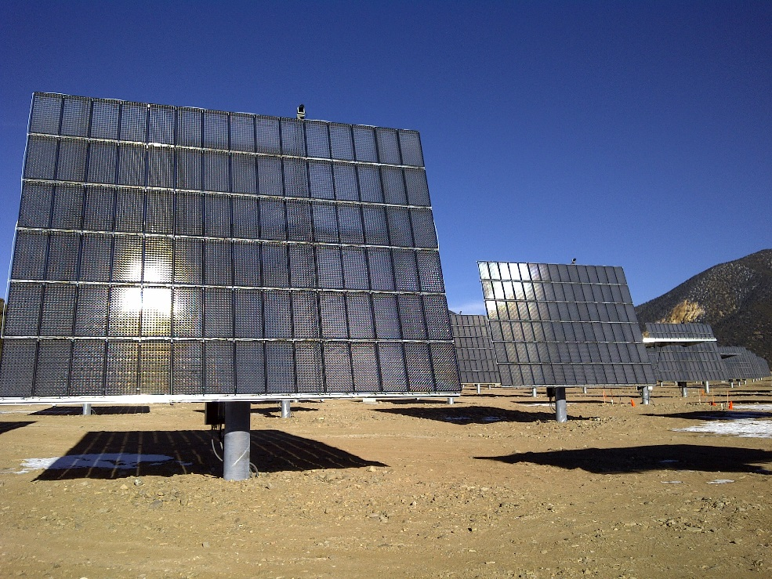
SRI: Superfund Redevelopment Initiative
Working with communities and other partners in considering future use
opportunities and integrating appropriate reuse options into the cleanup process
https://www.epa.gov/superfund-redevelopment-initiative

Slide 4
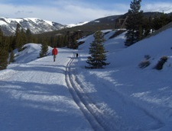
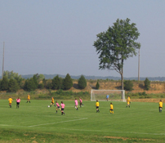
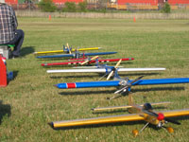
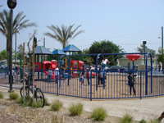
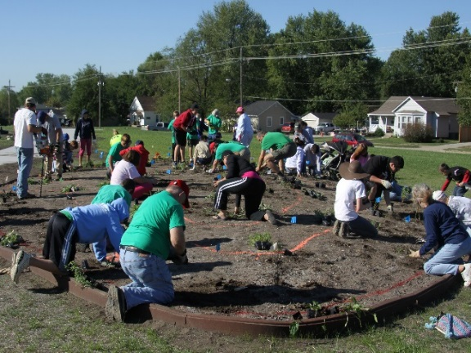
Redevelopment Partnerships
Rails-to-Trails Conservancy support at California Gulch Superfund site, Colorado
U.S. Soccer Foundation support at Avtex Fibers Superfund site, Virginia
Academy of Model Aeronautics support at Auburn Road Landfill Superfund site, New Hampshire
https://www.epa.gov/superfund-redevelopment-initiative/redevelopment-partnerships
The Trust for Public Land support at Pemaco Maywood Superfund site, California
Pollinator Partnership (P2) at Chemical Commodities Inc. Superfund site, Kansas

